Slide 1
Data Science
- By Papri

Slide 2
Topics For the Day
Introduction to Data Science
Data Science : Components & Tools
Life Cycle
Types of Data Scientists / Roles
Demand
Use Cases
Practical Tips
Linear Regression
Salary Prediction based on Job Profile Demo

Slide 3
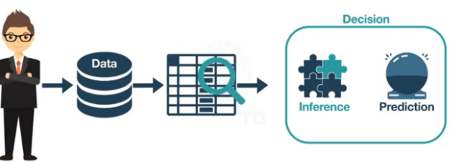
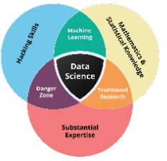
What is Data Science?
Data driven science – interdisciplinary field
Stands on 3 pillars – Where, what, how
“Data science is all about using data to solve problems”
Notes:
Interdisciplinary field

Slide 4
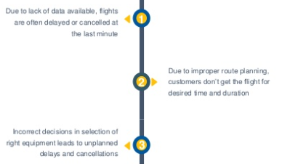
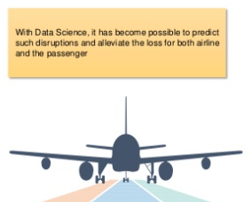
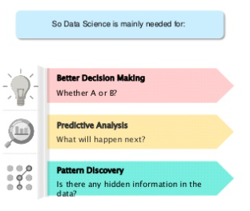
Need for Data Science

Slide 5
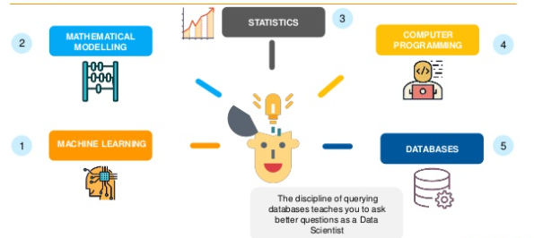
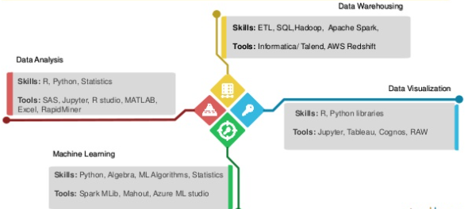
Components & Tools

Slide 6
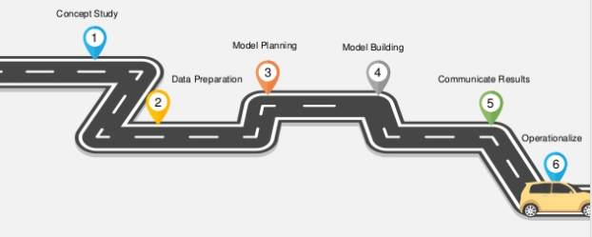
Life Cycle
Notes:
Interdisciplinary field

Slide 7
Job Roles in Data Science
Data Analyst
Data Engineers
Database Administrator
Machine Learning Engineer
Data Scientist
Data Architect
Statistician
Business Analyst
Data and Analytics Manager
Notes:
Interdisciplinary field

Slide 8
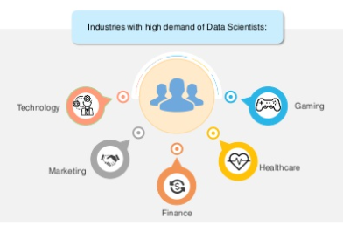
Demand for Data Scientists
Aviation
Logistics
E-commerce
HR
Real Estate

Slide 9
Application Use Cases
Fraud and Risk Detection
Healthcare
Internet Search
Targeted Advertising
Website Recommendations
Advanced Image Recognition
Speech Recognition
Airline Route Planning
Gaming
Augmented Reality

Slide 10
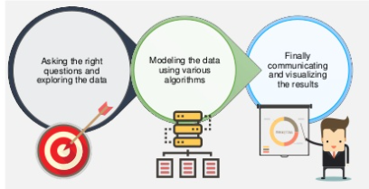
Practical Tips
“3C” Traits to be a Data Scientist
Curiosity
Common Sense
Communication
Notes:
Interdisciplinary field

Slide 11
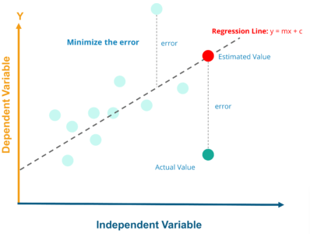
Linear Regression
A linear regression is one of the easiest statistical models to show the linear relationship between a dependent variable and one or more independent variables
Regression Line, y = mx+c where, y = Dependent Variable x= Independent Variable ; c = y-Intercept
Notes:
Interdisciplinary field

Slide 12
Demo
Notes:
Interdisciplinary field

